Slide 1
Triton for MTIA
Roman Levenstein, Shintaro Iwasaki, Ilia Cherniavskii

Slide 2
Presentation outline
What is MTIA?
Motivation for Triton for MTIA
Triton for MTIA feasibility study
Current functionality and performance of the prototype
Next steps
Open questions about Triton support for heterogeneous HW
Conclusion

Slide 3
What is MTIA?

Slide 4

Meta Training and Inference Accelerator (MTIA)
Meta’s first in-house ML accelerator
Main goals:
Perf/TCO
Generality and programmability
High Dev Efficiency via first-class integration with PyTorch and great support for kernel authoring
Publicly announced MTIA in May 2023
More information:
MTIA blog post
MTIA video presentation
MTIA ISCA’23 paper

Slide 5
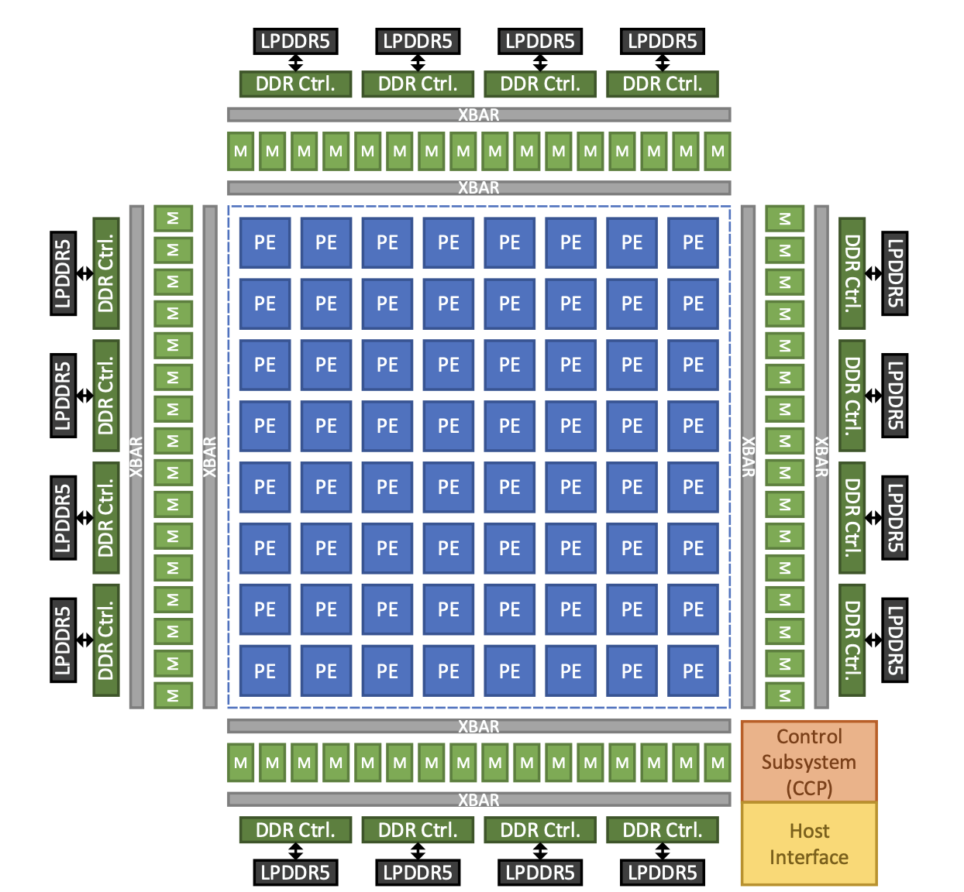
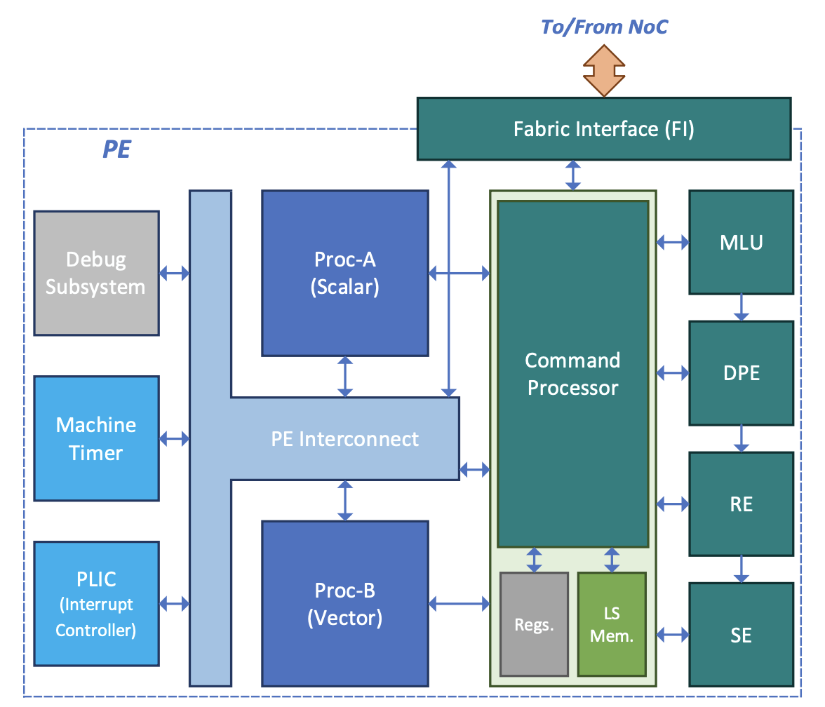
MTIA high-level HW architecture
High-level architecture of the accelerator
PE’s internal organization

Slide 6
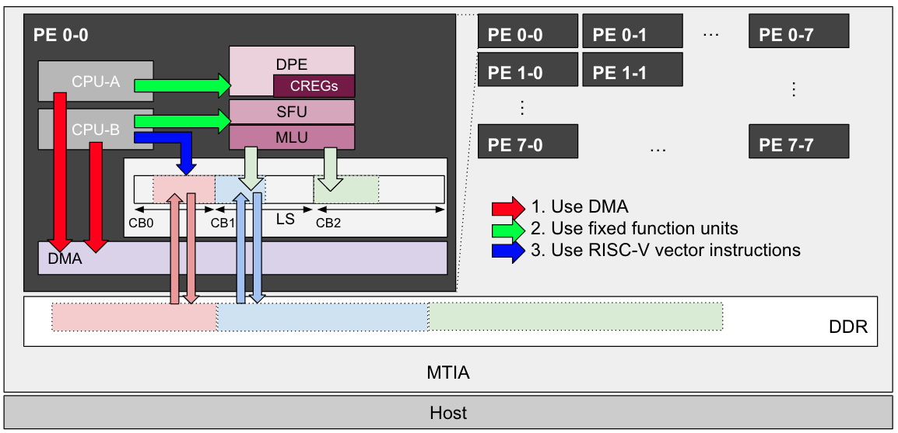
MTIA Programming
SPMD programming model for kernels
Supported via MTIA-specific KNYFE DSL
Lower-level C++ APIs
A typical MTIA kernel does the following:
Loads data from DRAM/LLS to CBs (circular buffers) in local memory (LS) using DMA transfers
Performs computation with data in CBs using the fixed function units
Writes data back to DRAM using transfers
Execution on fixed-function units is asynchronous and data-flow driven via CB-based data-dependencies between ISA instructions

Slide 7
Motivation for Triton for MTIA

Slide 8
Why Triton for MTIA?
Growing Triton adoption
Triton gets adopted in the industry (that’s why all of us are here today!)
Triton gets traction at Meta recently
PyTorch 2.0 adopted Triton to automatically fuse and optimize PyTorch operators for GPUs (via TorchInductor)
Some teams author new kernels in Triton since writing Triton is easier than writing CUDA
High developer efficiency is critical to MTIA success
North Star vision: improve developer’s efficiency by unifying development flows and tools for ML engineers by using Triton for GPUs and MTIA
But Triton is primarily designed for GPUs

Slide 9
Triton for MTIA feasibility study

Slide 10
Proving feasibility by developing a working prototype to answer main open questions
Can Triton be efficiently lowered to run on MTIA HW?
Generated kernels should make effective use of major HW units (DPE, SFU, DMA, LS, CB, RISC-V vector cores)
Performance should be comparable to current KNYFE DSL generated kernels
If not, what would be critical blockers for Triton on MTIA?
Figure out if blockers are conceptual issues impossible to resolve
Propose resolution for these blockers (e.g. Triton extensions, HW architecture changes in the future generations of MTIA, etc)

Slide 11
Prototype Overview: Software Diagram
Triton Code
Triton
Triton for MTIA Prototype
Triton-MLIR (MLIR Dialect)
TritonGPU-MLIR (MLIR Dialect)
TritonMTIA-MLIR (MLIR Dialect)
MTIA Clang/LLVM
MTIA-MLIR
C/C++
LLVM-MLIR / LLVM-IR
LLVM-MLIR / LLVM-IR
PTXAS/CUBIN
RISC-V Binary for MTIA
Triton for CUDA
Triton for MTIA Prod
Triton for MTIA Prototype
Note: Triton DSL -> MTIA C++ lowering is done for a quick prototype purposes only; The proper Triton for MTIA implementation will be MLIR based

Slide 12
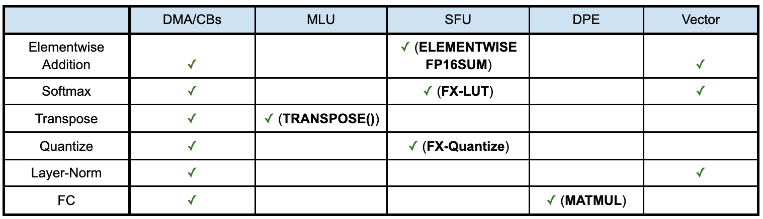
Prototype Functionality Coverage
Triton for MTIA prototype is able to generate kernels making use of all major HW fixed-function units

Slide 13
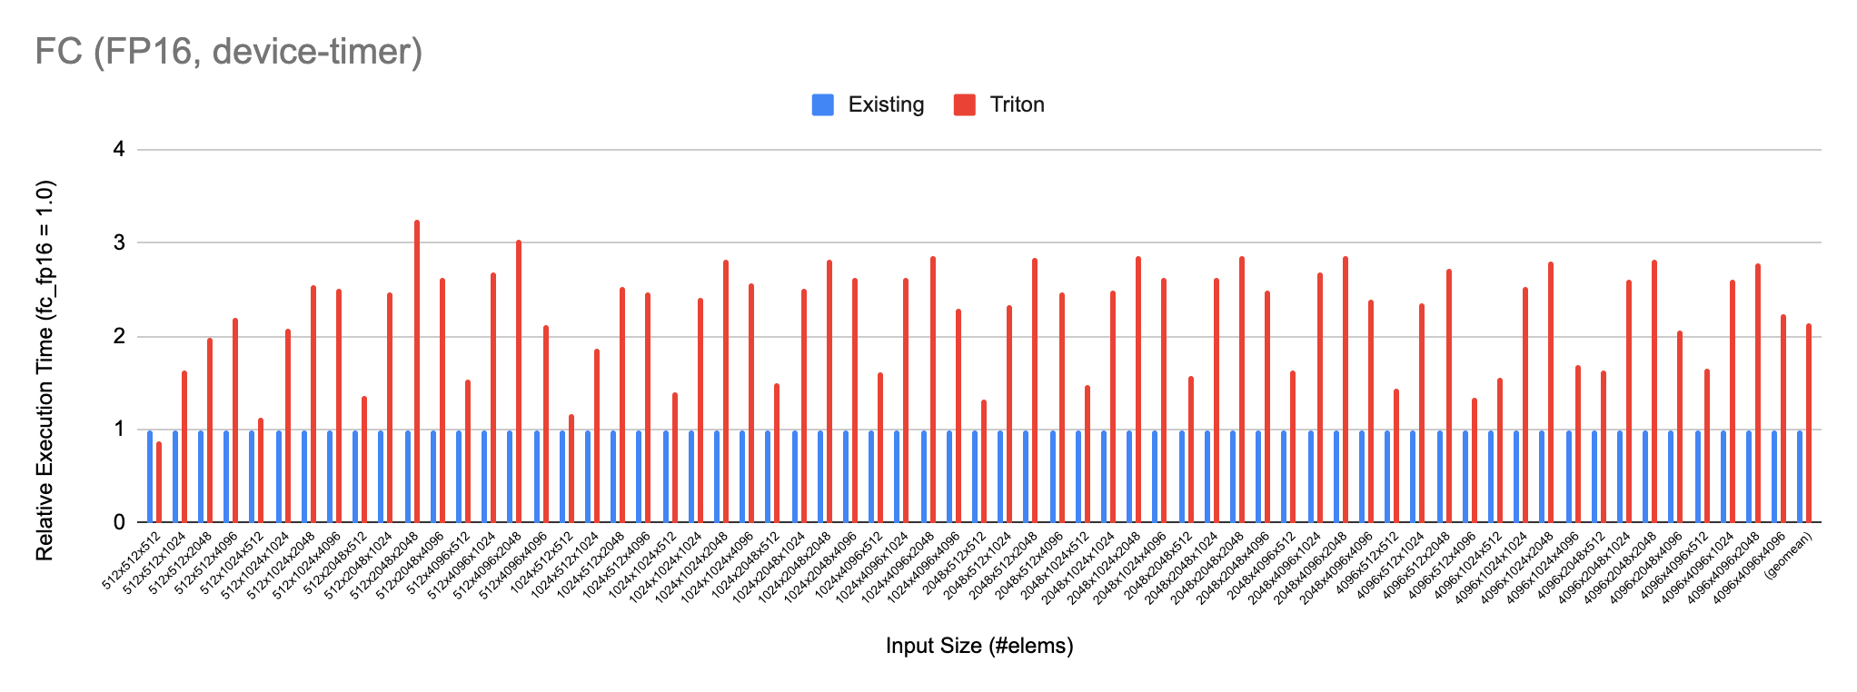
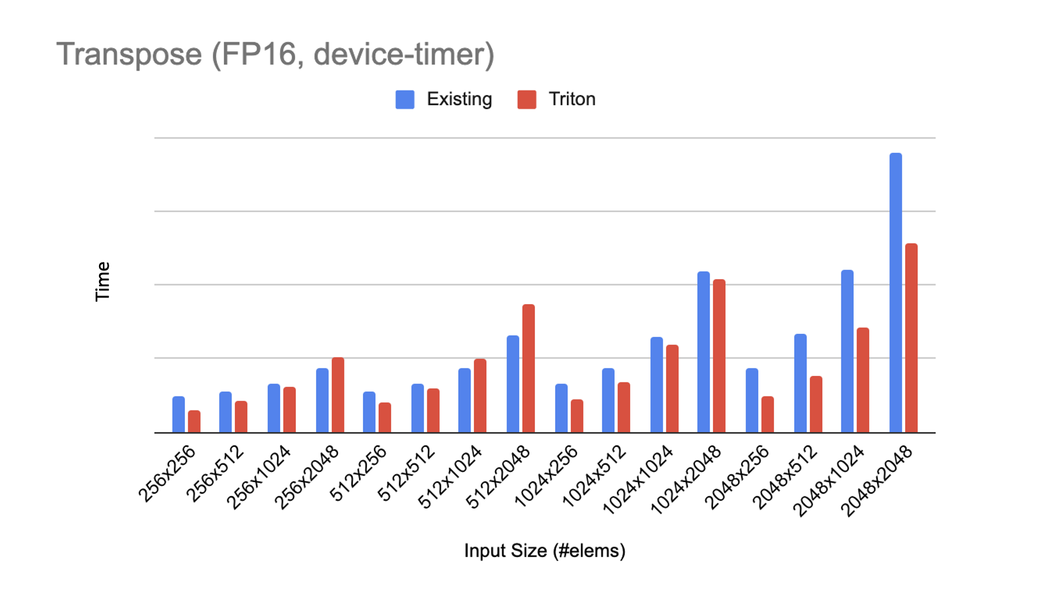
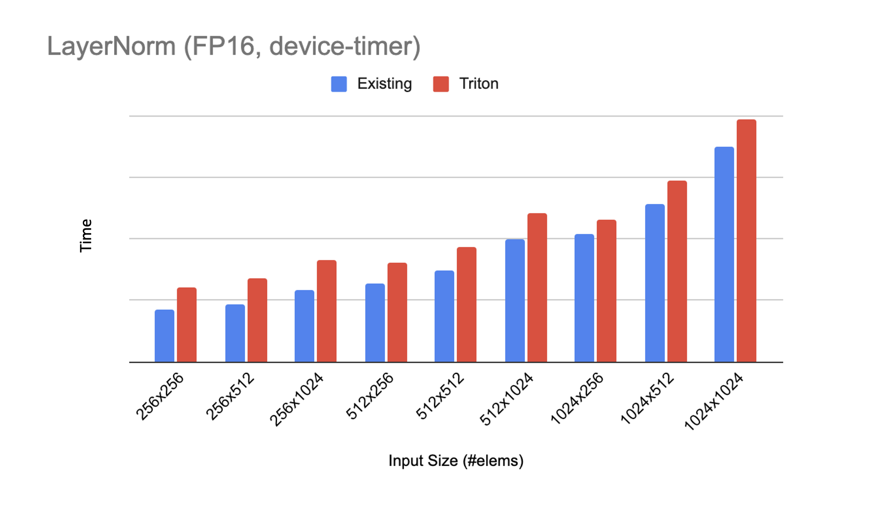
Prototype performance
Kernels generated by the Triton for MTIA prototype showed performance comparable with manual/KNYFE kernels for long-tail operators
Kernels for FCs (fully-connected layers) cannot match the performance of existing optimized kernels
More MTIA-specific optimizations are required to use the HW reduction network and DMA broadcasts in the PE-grid
May need some Triton extensions
Execution Time. Lower is better.

Slide 14
Next steps

Slide 15
Productization of Triton for MTIA
Decision is made based on promising results of the Triton for MTIA feasibility study and prototype
Productized version will be a proper Triton backend for MTIA
Use MLIR compilation flows
Introduce MTIA specific dialects and lowerings in the lower part of the compilation pipeline
Improve PT2/TorchInductor -> Triton integration to better support Triton for MTIA
Triton Code
KNYFE Code (BLOCK)
Triton
KNYFE DSL
Triton-MLIR (MLIR Dialect)
FILTER-IR
TritonGPU-MLIR (MLIR Dialect)
TritonMTIA-MLIR (MLIR Dialect)
MTIA Clang/LLVM
MTIA-MLIR
Shared between Triton and KNYFE
LLVM-MLIR / LLVM-IR
LLVM-MLIR / LLVM-IR
PTXAS/CUBIN
RISC-V Binary for MTIA
Triton for CUDA
Triton for MTIA
KNYFE (DSL for MTIA)

Slide 16
Open questions about Triton support for heterogeneous HW

Slide 17
Need for improved support for memory subsystems
Support for DMA-friendly memory access
ML accelerators often cannot use random access to memory efficiently or cannot use it at all
Need to use DMAs for efficient access
DMAs can typically only read/write a strided region (with other restrictions)
Traditional Triton kernels still use a tensor of pointers for tl.load() and tl.store()
Inferring that load()/store() are actually working with DMA-friendly memory region is non-trivial in general case
Wider use of Block Pointers is preferred
Easy to map to DMAs on ML accelerators
Would help on GPUs too
Support for additional/custom levels of memory hierarchies
E.g. MTIA has LLS (Last Level Scratch) with configurable size and shared across PEs, which cannot be easily utilized by Triton currently
It would be good if Triton would allow for defining/using custom levels of memory hierarchy

Slide 18
Need for improved support for asynchronous execution
Triton as of today is fundamentally an imperative DSL
No support for exploiting the asynchronous nature of some custom HW units or async APIs
Execution on MTIA fixed-function units is asynchronous and based on a data-flow pattern; DMAs are also asynchronous
Recent versions of CUDA introduced some asynchronous APIs too
Likely requires Triton DSL and semantics extensions

Slide 19
Need for supporting cross-PE primitives and PE topology-aware codegen for custom HW targets
Lack of support for DMA-broadcast and inter-PE reduction significantly hurts the performance of GEMM-like kernels on MTIA
Efficient GEMM implementations are HW topology-aware (row-wise/column-wise synchronizations and reductions)
Hard to express them within the current Triton arbitrary and topology-unaware mapping between program instances and PEs
As GEMMs are special (e.g., PT2 has a special template for GEMM-like kernels), we likely just need good abstractions that can be well understood by the Triton-MTIA compiler
Reasonable extension to Triton/special pattern matching in the compiler with reasonable fusion capabilities

Slide 20
Conclusion
Triton provides a reasonable and good unifying programming abstraction for GPUs, MTIA and many other HWs
Triton improves developer efficiency of kernel authoring
Triton for MTIA is proven feasible and it will be productized
Meta welcomes efforts to improve Triton DSL and its implementation towards better support of heterogeneous HW and would like to participate in such efforts
We are hiring! :-)

